Slide 1
Mrs. Shore’s Sailors
2016-2017
4th Grade Class
Franklin Academy

Slide 2
Fall pumpkin decoration

Slide 3
Spirit week- red, white & blue

Slide 4
Spirit week- 70’s & 80’s

Slide 5
Spirit week-Sport teams

Slide 6
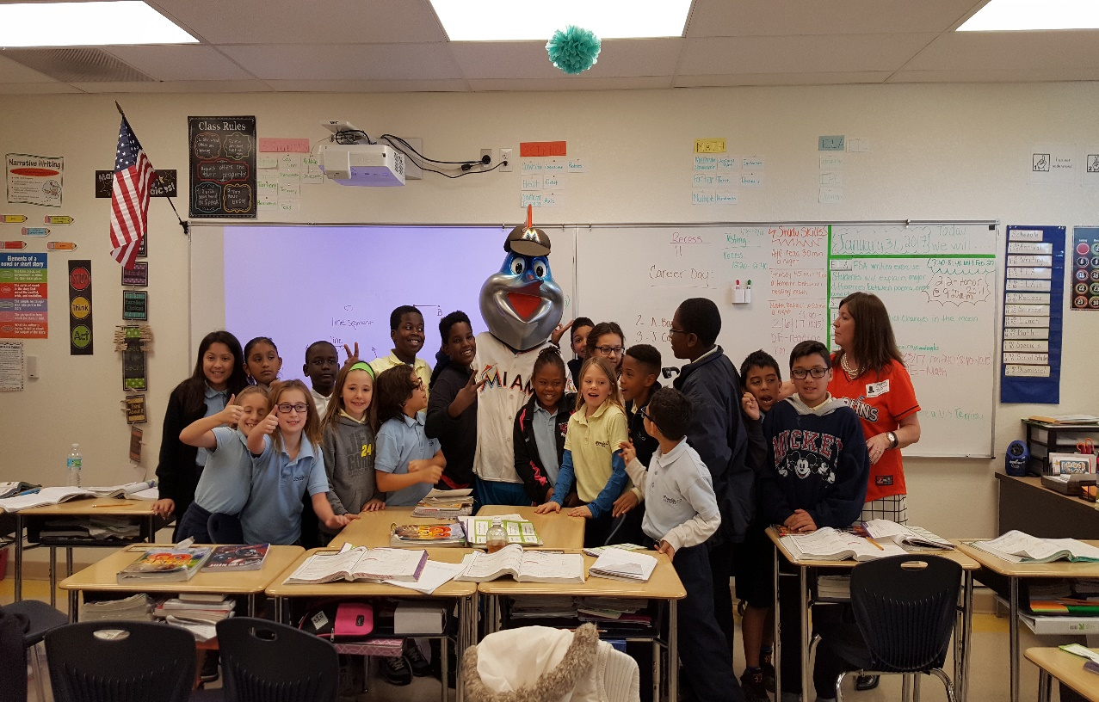
Billy time!

Slide 7
Book-nic

Slide 8
Book-nic

Slide 9
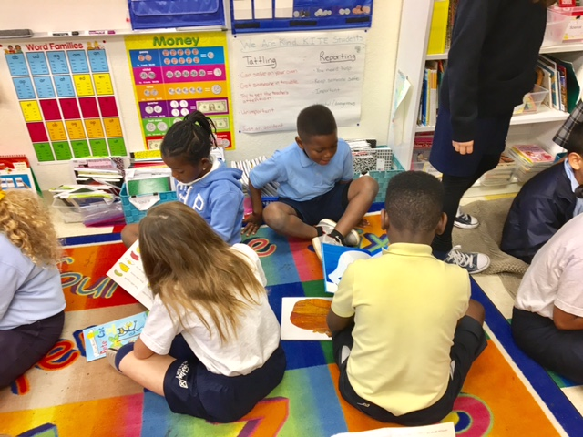
Book buddies

Slide 10
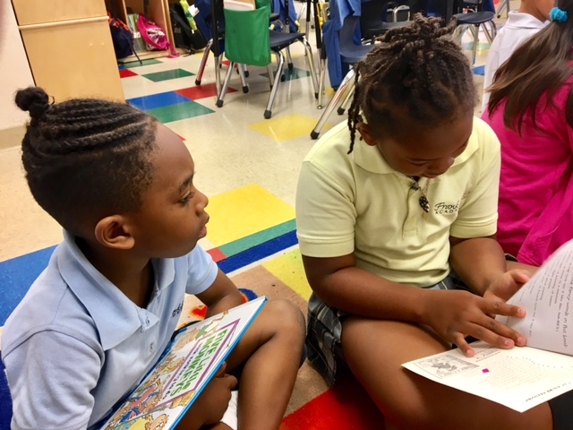
Book buddies

Slide 11
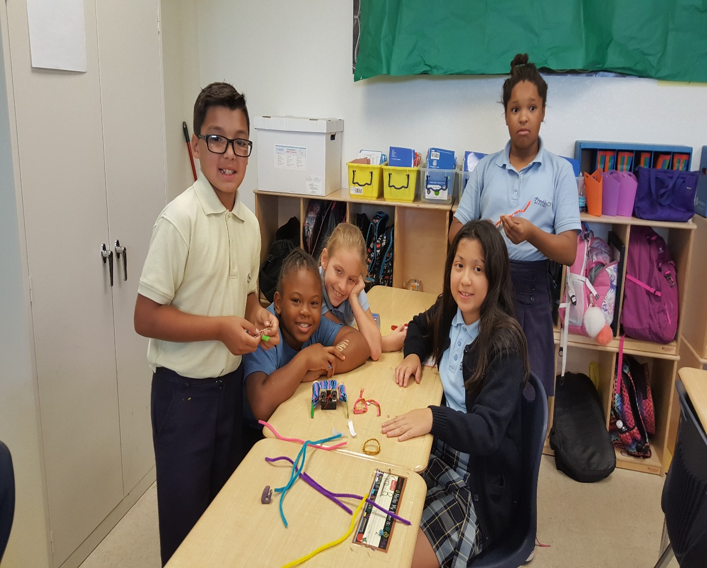
Stem

Slide 12
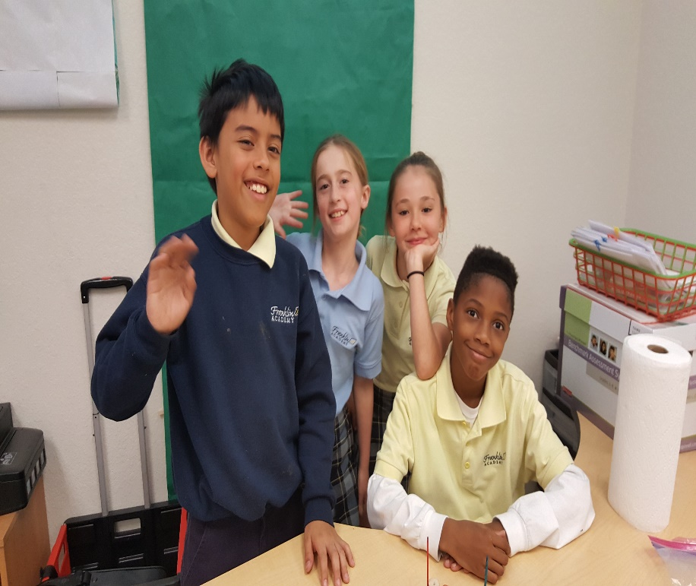
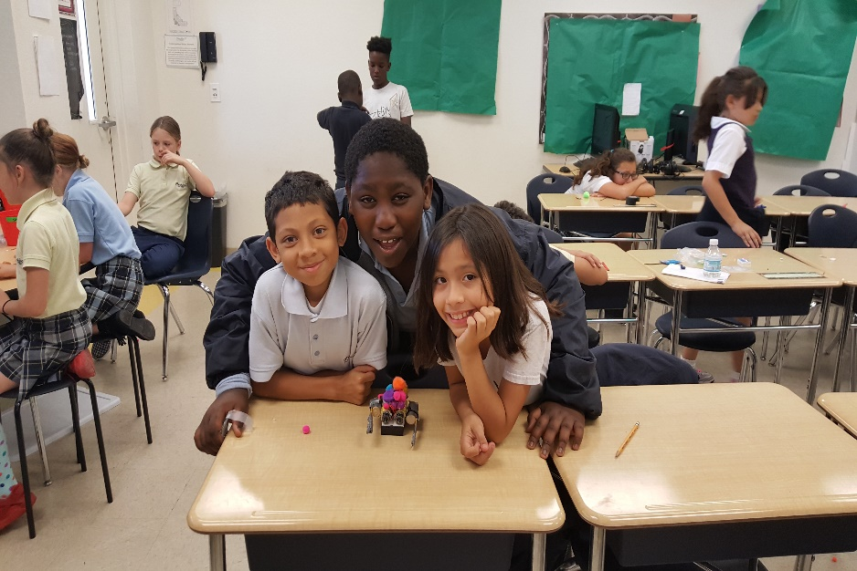
stem

Slide 13
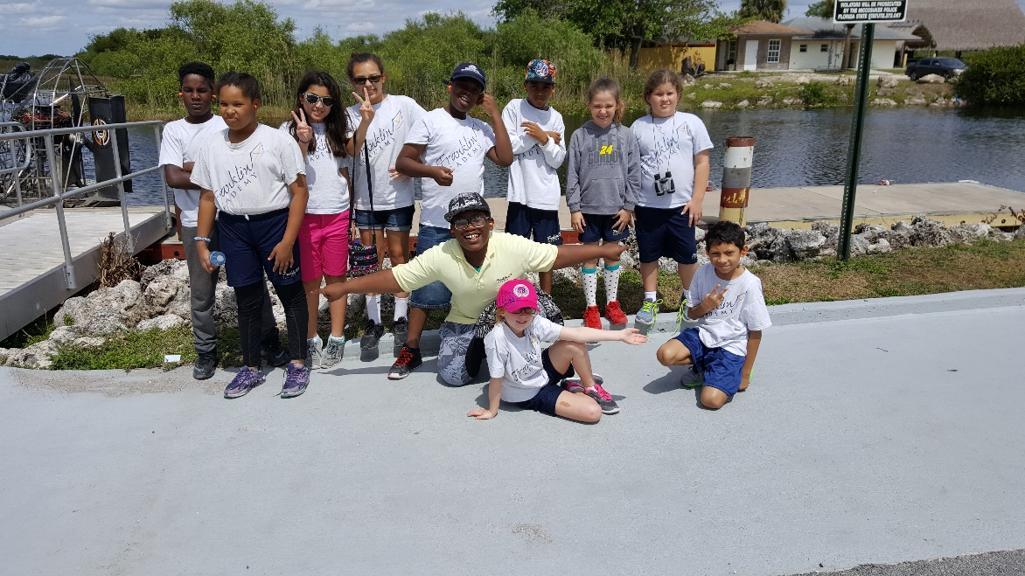
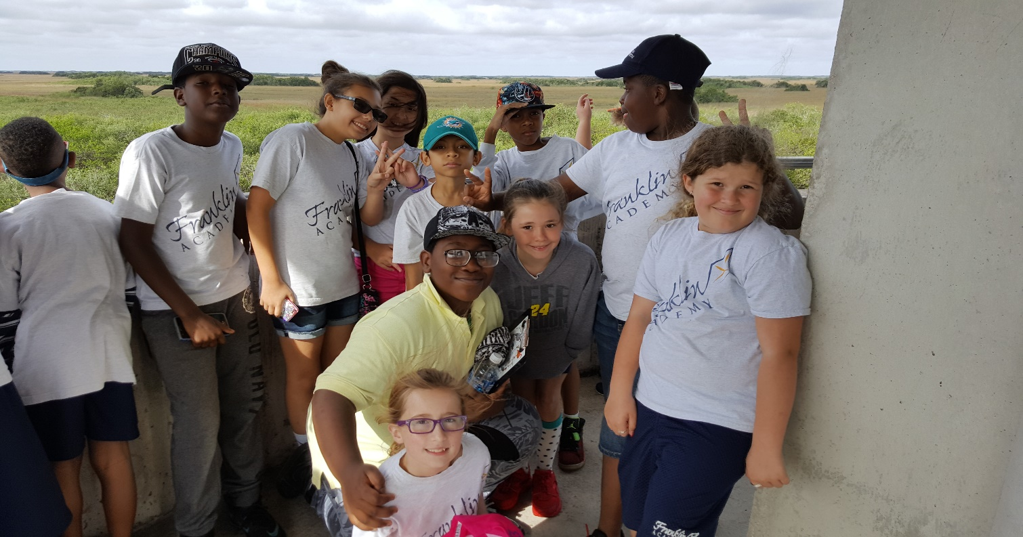
Everglades

Slide 14
Miami sea aquarium

